Slide 1
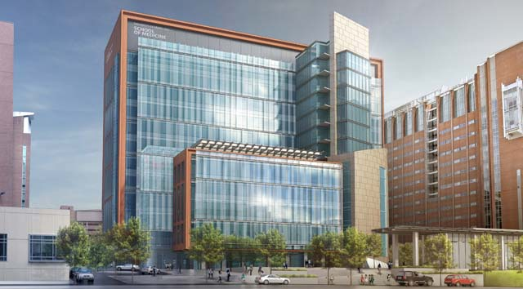

UNIVERSITY OF MARYLAND – BALTIMORE
HEALTH SCIENCES FACILITY III
SENIOR THESIS PRESENTATION
KENNETH M. MOORE
LIGHTING / ELECTRICAL
THESIS ADVISOR │ SHAWN GOOD

Slide 2
PROJECT OVERVIEW
PROJECT OVERVIEW PROJECT LOCATION DESIGN CONCEPT ELEVATOR LOBBY NANOMEDICINE WORKSTATION MEETING ROOM REPORT BREADTHS ELECTRICAL DEPTH REPORT SUMMARY
BACKGROUND

Slide 3
SOUTH FAÇADE
HIGHLY ADVANCED RESEARCH FACILITY
HOUSES RESEARCH GROUPS FOR SCHOOLS OF MEDICINE, PHARMACY, AND DENTISTRY
ARCHITECT
HELLMUTH, OBATA, KASSABAUM (HOK)
CONSTRUCTION MANAGER
BARTON MALOW COMPANY
OWNED BY UMB OFFICE OF FACILITIES MANAGEMENT
“The Health Sciences Facility III further strengthens our footprint in west Baltimore and, as a result, our economic impact on the city and the state. We’re privileged to be able to help revitalize our critically important Baltimore neighborhoods and the state of Maryland as a whole, and at the same time, enable biomedical research and education that has the potential to save lives.”
Jay A. Perman, MD
President, University of Maryland
PROJECT OVERVIEW PROJECT LOCATION DESIGN CONCEPT ELEVATOR LOBBY NANOMEDICINE WORKSTATION MEETING ROOM REPORT BREADTHS ELECTRICAL DEPTH REPORT SUMMARY
BACKGROUND

Slide 4
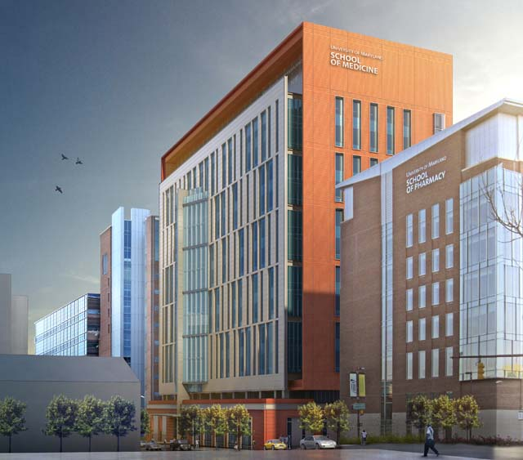
NORTH FAÇADE
SOUTH FAÇADE
PROJECT SIZE
430,000 GSF
CONSTRUCTION TIMELINE
JULY 2013 – SEPTEMBER 2017
PROJECT CONSTRUCTION COST
$ 216,000,000.00
PROJECT DELIVERY
CM AT RISK
PROJECT OVERVIEW PROJECT LOCATION DESIGN CONCEPT ELEVATOR LOBBY NANOMEDICINE WORKSTATION MEETING ROOM REPORT BREADTHS ELECTRICAL DEPTH REPORT SUMMARY
BACKGROUND

Slide 5
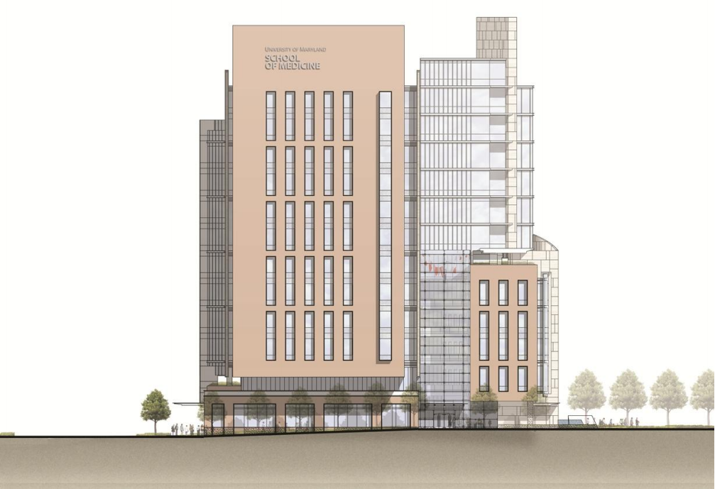
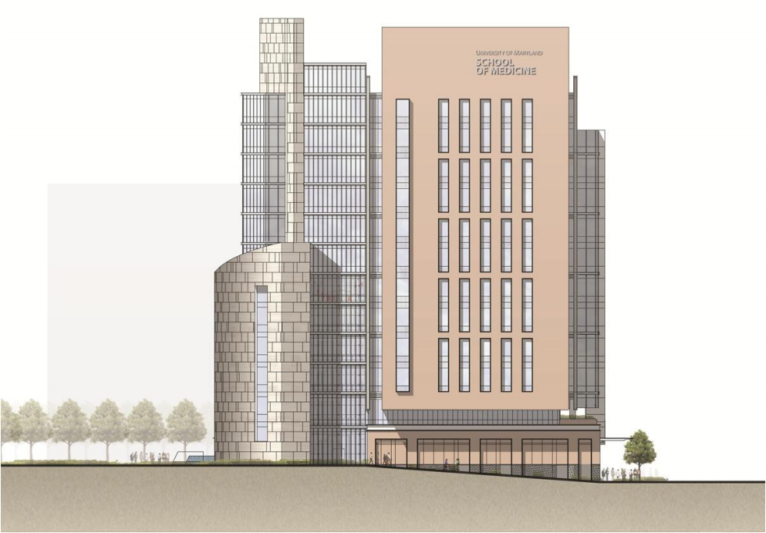
13 STORIES
MECHANICAL MEZZANINE + PENTHOUSE
7 STORY ATRIUM + 3 MAIN TOWERS
WET LAB + DRY LAB
GREEN ROOF
WEST ELEVATION
EAST ELEVATION
PROJECT OVERVIEW PROJECT LOCATION DESIGN CONCEPT ELEVATOR LOBBY NANOMEDICINE WORKSTATION MEETING ROOM REPORT BREADTHS ELECTRICAL DEPTH REPORT SUMMARY
BACKGROUND

Slide 6
PROJECT LOCATION
PROJECT OVERVIEW PROJECT LOCATION DESIGN CONCEPT ELEVATOR LOBBY NANOMEDICINE WORKSTATION MEETING ROOM REPORT BREADTHS ELECTRICAL DEPTH REPORT SUMMARY
BACKGROUND

Slide 7
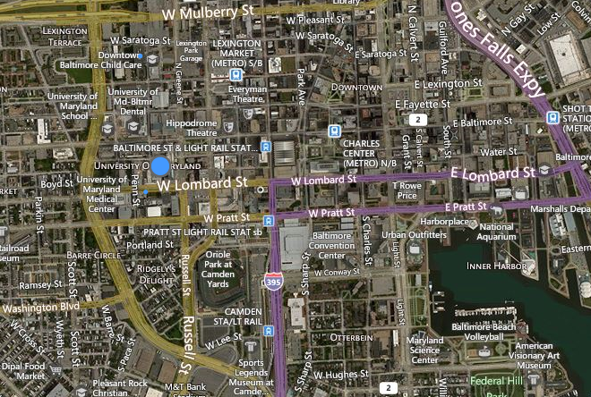
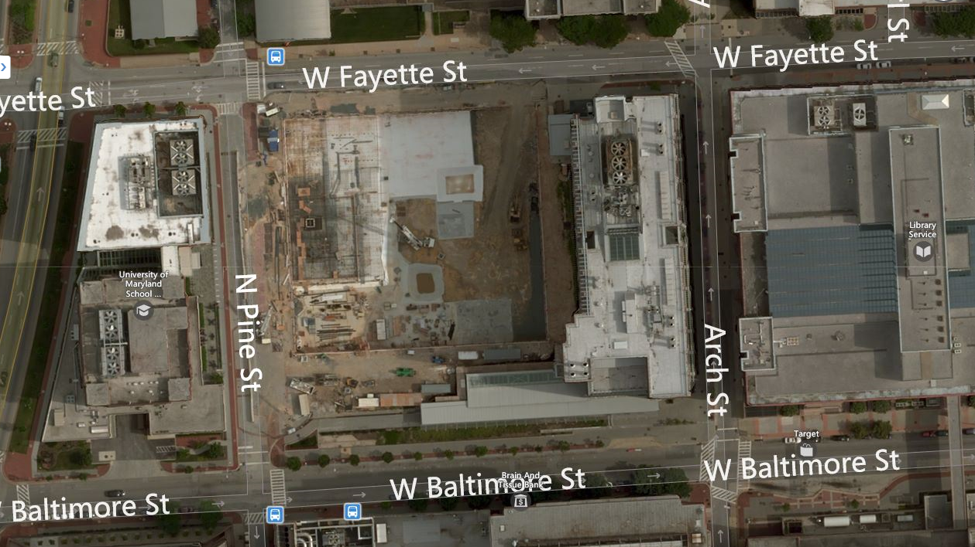

666 W. BALTIMORE ST.
CITY OF BALTIMORE
SEVERAL BLOCKS FROM INNER HARBOR
CENTRAL LOCATION IN UNIVERSITY CAMPUS
PROJECT OVERVIEW PROJECT LOCATION DESIGN CONCEPT ELEVATOR LOBBY NANOMEDICINE WORKSTATION MEETING ROOM REPORT BREADTHS ELECTRICAL DEPTH REPORT SUMMARY

Slide 8
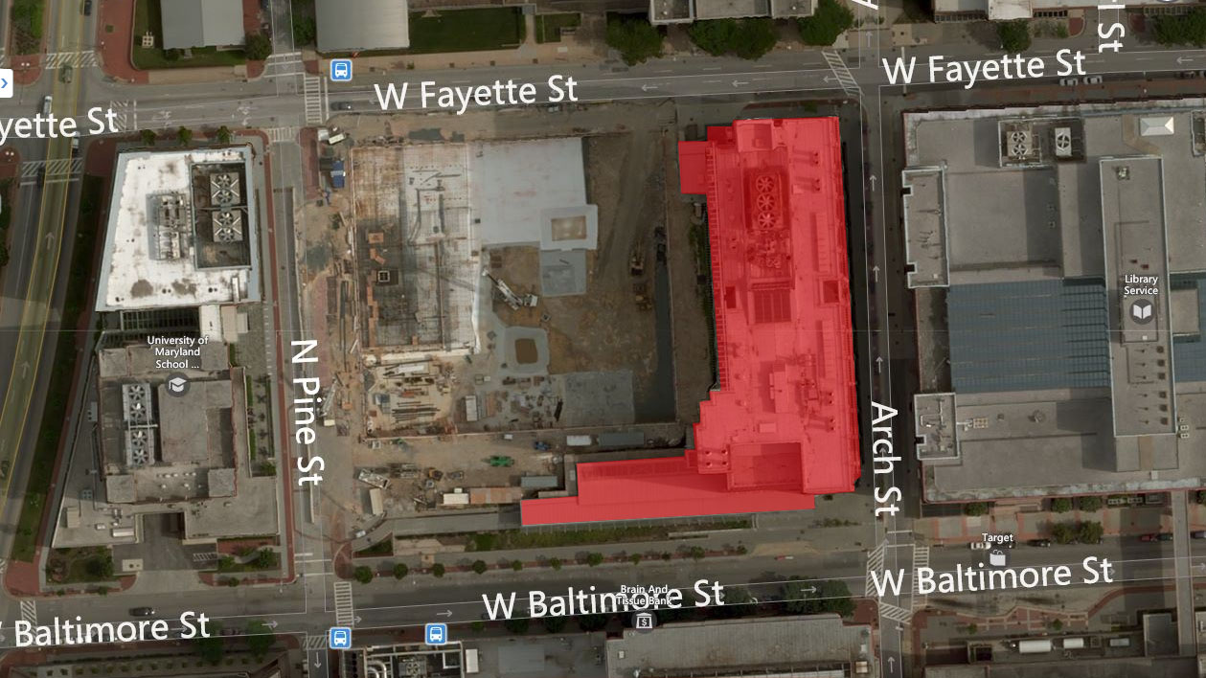
666 W. BALTIMORE ST.
SCHOOL OF DENTISTRY
PROJECT OVERVIEW PROJECT LOCATION DESIGN CONCEPT ELEVATOR LOBBY NANOMEDICINE WORKSTATION MEETING ROOM REPORT BREADTHS ELECTRICAL DEPTH REPORT SUMMARY

Slide 9
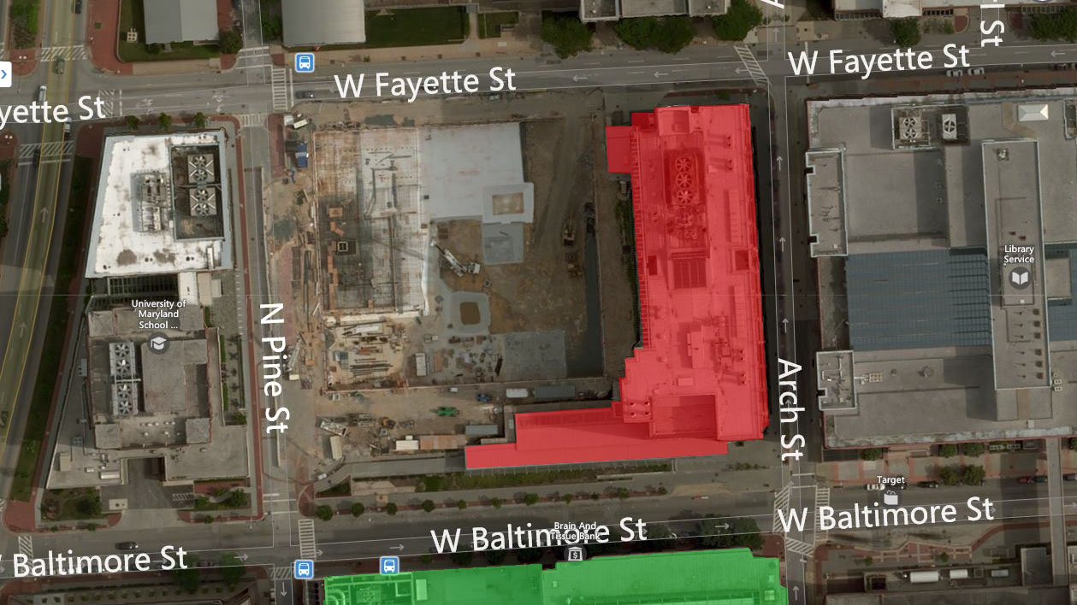
666 W. BALTIMORE ST.
SCHOOL OF DENTISTRY
SCHOOL OF MEDICINE
PROJECT OVERVIEW PROJECT LOCATION DESIGN CONCEPT ELEVATOR LOBBY NANOMEDICINE WORKSTATION MEETING ROOM REPORT BREADTHS ELECTRICAL DEPTH REPORT SUMMARY

Slide 10
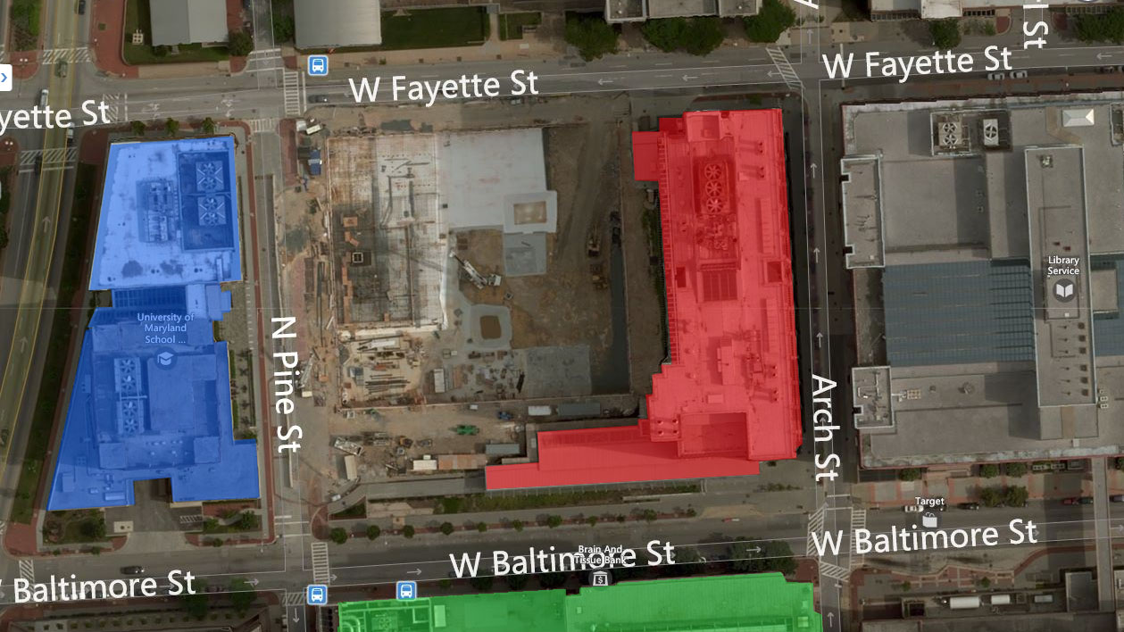
666 W. BALTIMORE ST.
SCHOOL OF DENTISTRY
SCHOOL OF MEDICINE
SCHOOL OF PHARMACY
PROJECT OVERVIEW PROJECT LOCATION DESIGN CONCEPT ELEVATOR LOBBY NANOMEDICINE WORKSTATION MEETING ROOM REPORT BREADTHS ELECTRICAL DEPTH REPORT SUMMARY

Slide 11
DESIGN CONCEPT
PROJECT OVERVIEW PROJECT LOCATION DESIGN CONCEPT ELEVATOR LOBBY NANOMEDICINE WORKSTATION MEETING ROOM REPORT BREADTHS ELECTRICAL DEPTH REPORT SUMMARY
BACKGROUND

Slide 13
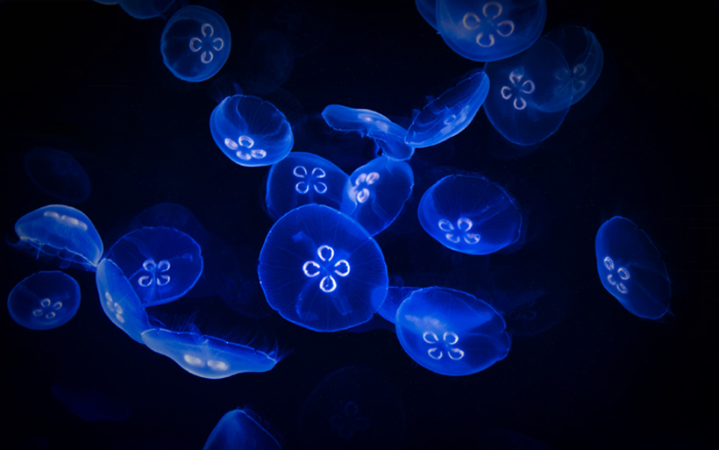
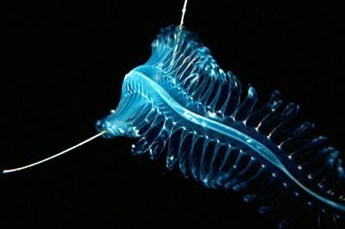
BIOLUMINESCENCE
PRODUCTION AND EMISSION OF LIGHT BY A LIVING ORGANISM
GREEK: BIOS MEANING “LIVING”
LATIN: LUMEN MEANING “LIGHT”
PROJECT OVERVIEW PROJECT LOCATION DESIGN CONCEPT ELEVATOR LOBBY NANOMEDICINE WORKSTATION MEETING ROOM REPORT BREADTHS ELECTRICAL DEPTH REPORT SUMMARY

Slide 14
ELEVATOR LOBBY
PROJECT OVERVIEW PROJECT LOCATION DESIGN CONCEPT ELEVATOR LOBBY NANOMEDICINE WORKSTATION MEETING ROOM REPORT BREADTHS ELECTRICAL DEPTH REPORT SUMMARY
BACKGROUND

Slide 15
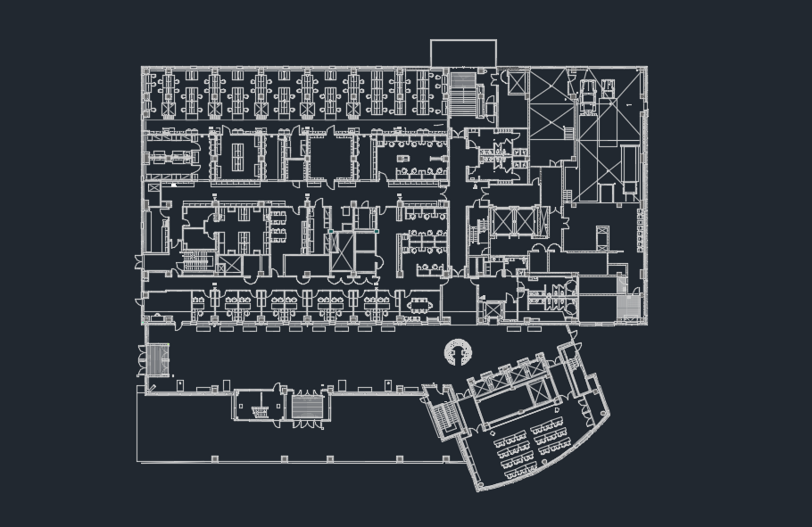
PROJECT OVERVIEW PROJECT LOCATION DESIGN CONCEPT ELEVATOR LOBBY NANOMEDICINE WORKSTATION MEETING ROOM REPORT BREADTHS ELECTRICAL DEPTH REPORT SUMMARY

Slide 16
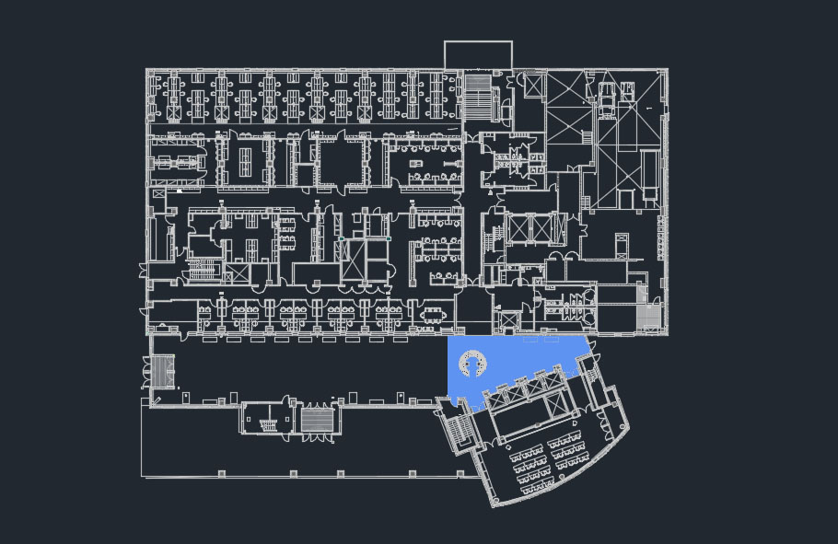
ELEVATOR LOBBY
DESIGN CRITERIA
EFFECTIVE CENTER OF PEDESTRIAN ACTIVITY
ACCESSED VIA MAIN ATRIUM
4 PEDESTRIAN ELEVATORS + STAFF ELEVATOR
CENTRAL INFORMATION DESK
CONNECTS TO MEETING ROOM SPACE
HIGH PEDESTRIAN ACTIVITY
Circulation, Elevator Lobbies | Horizontal (fc) Targets | Vertical (fc) Targets | Avg:Min
Day | 10 | 3 | 4:1
Night | 5 | 2 | 4:1
H @floor; V @ 5’ AFF.
Reception Lobbies | Horizontal (fc) Targets | Vertical (fc) Targets | Avg:Min
Desk Top | 15 | 5 | 4:1
H @3’6” AFF; V @ 5’AFF
Common Space Types | LPD (W/ft²)
General Lobby Space | 0.90
PROJECT OVERVIEW PROJECT LOCATION DESIGN CONCEPT ELEVATOR LOBBY NANOMEDICINE WORKSTATION MEETING ROOM REPORT BREADTHS ELECTRICAL DEPTH REPORT SUMMARY

Slide 17
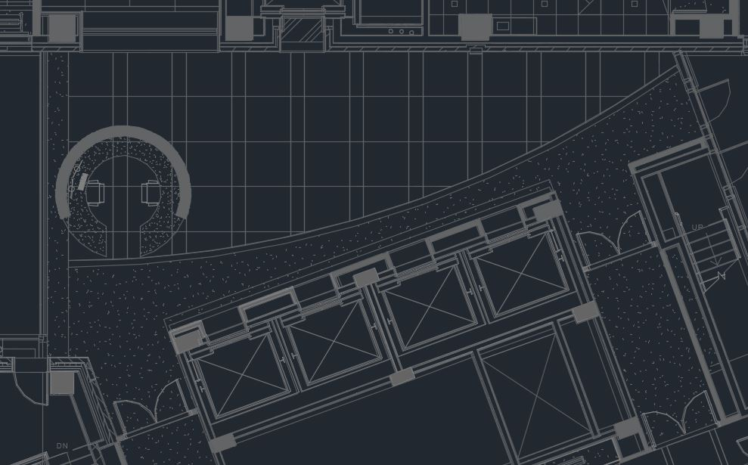
DESIGN CONSIDERATIONS
PROJECT OVERVIEW PROJECT LOCATION DESIGN CONCEPT ELEVATOR LOBBY NANOMEDICINE WORKSTATION MEETING ROOM REPORT BREADTHS ELECTRICAL DEPTH REPORT SUMMARY

Slide 18
DESIGN CONSIDERATIONS
MECHANICAL SUPPLY VENTS
PROJECT OVERVIEW PROJECT LOCATION DESIGN CONCEPT ELEVATOR LOBBY NANOMEDICINE WORKSTATION MEETING ROOM REPORT BREADTHS ELECTRICAL DEPTH REPORT SUMMARY

Slide 19
LUMINAIRE SUMMARY
PROJECT OVERVIEW PROJECT LOCATION DESIGN CONCEPT ELEVATOR LOBBY NANOMEDICINE WORKSTATION MEETING ROOM REPORT BREADTHS ELECTRICAL DEPTH REPORT SUMMARY

Slide 20
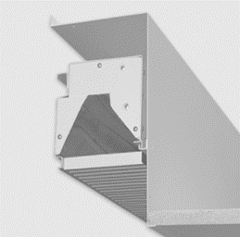
LUMINAIRE SUMMARY
RECESSED FLUORESCENT GRAZE DOWNLIGHT
PROJECT OVERVIEW PROJECT LOCATION DESIGN CONCEPT ELEVATOR LOBBY NANOMEDICINE WORKSTATION MEETING ROOM REPORT BREADTHS ELECTRICAL DEPTH REPORT SUMMARY

Slide 21
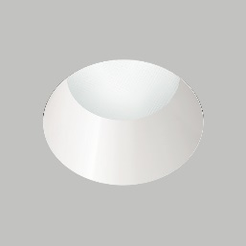
LUMINAIRE SUMMARY
RECESSED FLUORESCENT GRAZE DOWNLIGHT
RECESSED LED DOWNLIGHT – 13’ 6” MH
PROJECT OVERVIEW PROJECT LOCATION DESIGN CONCEPT ELEVATOR LOBBY NANOMEDICINE WORKSTATION MEETING ROOM REPORT BREADTHS ELECTRICAL DEPTH REPORT SUMMARY

Slide 22
LUMINAIRE SUMMARY
RECESSED FLUORESCENT GRAZE DOWNLIGHT
RECESSED LED DOWNLIGHT – 13’ 6” MH
RECESSED LED DOWNLIGHT – 13’ 2” MH
PROJECT OVERVIEW PROJECT LOCATION DESIGN CONCEPT ELEVATOR LOBBY NANOMEDICINE WORKSTATION MEETING ROOM REPORT BREADTHS ELECTRICAL DEPTH REPORT SUMMARY

Slide 23
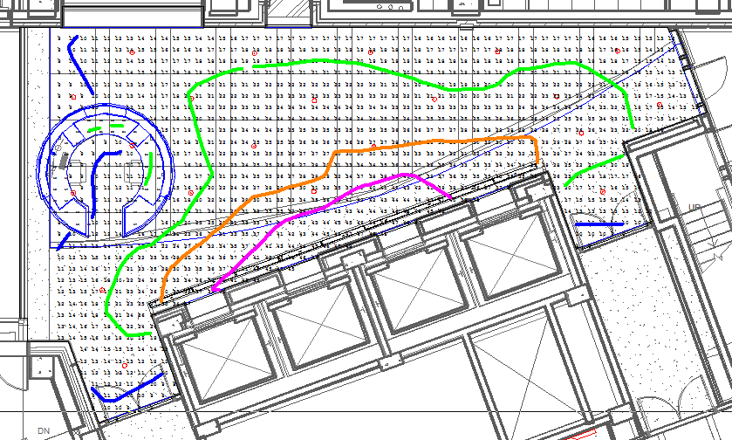
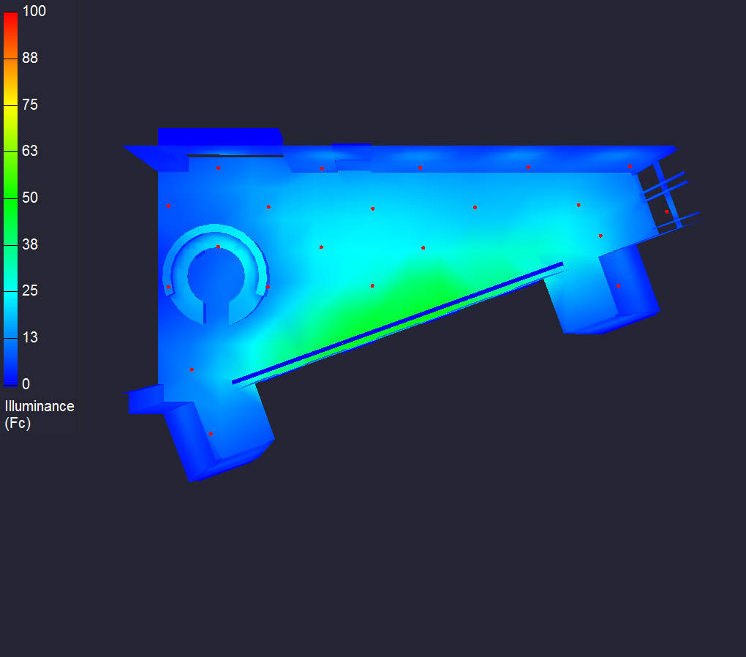
CALCULATION SUMMARY
10
20
30
40
PROJECT OVERVIEW PROJECT LOCATION DESIGN CONCEPT ELEVATOR LOBBY NANOMEDICINE WORKSTATION MEETING ROOM REPORT BREADTHS ELECTRICAL DEPTH REPORT SUMMARY

Slide 24
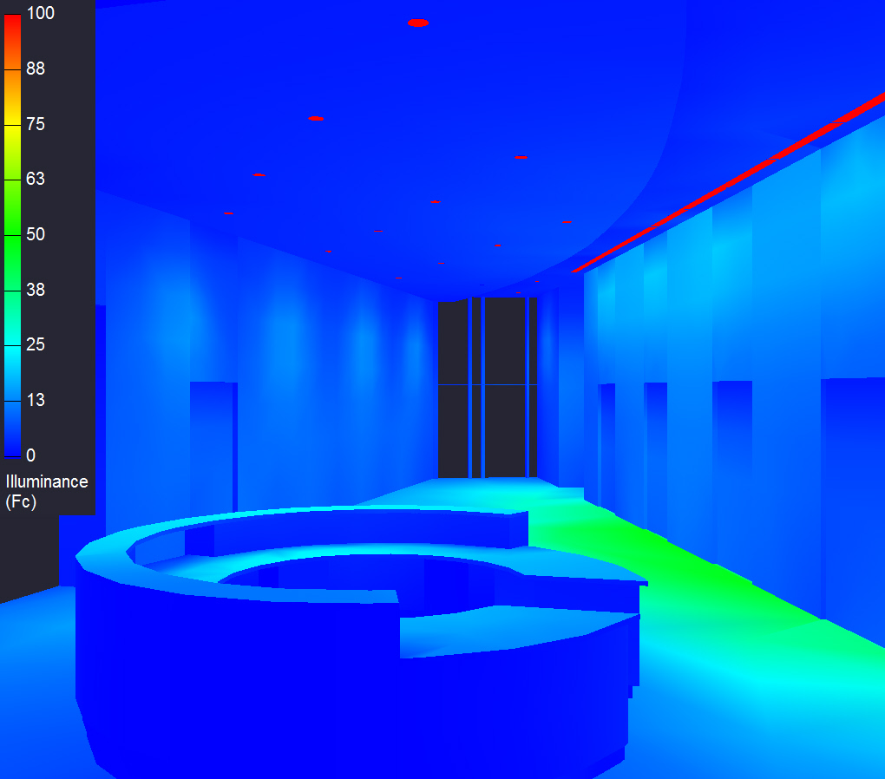
DESIGN SUMMARY
Lighting Criterion | Recommended Value | Achieved Value | Criteria Met
LPD Area Summary | < 0.9 W/ft² | 0.843 W/ft² | Yes
Average Target Illuminance | ≥ 10 fc | 22.3 fc | Yes
Desk Surface Illuminance | 15 fc | 16.8 fc | Yes
PROJECT OVERVIEW PROJECT LOCATION DESIGN CONCEPT ELEVATOR LOBBY NANOMEDICINE WORKSTATION MEETING ROOM REPORT BREADTHS ELECTRICAL DEPTH REPORT SUMMARY

Slide 25
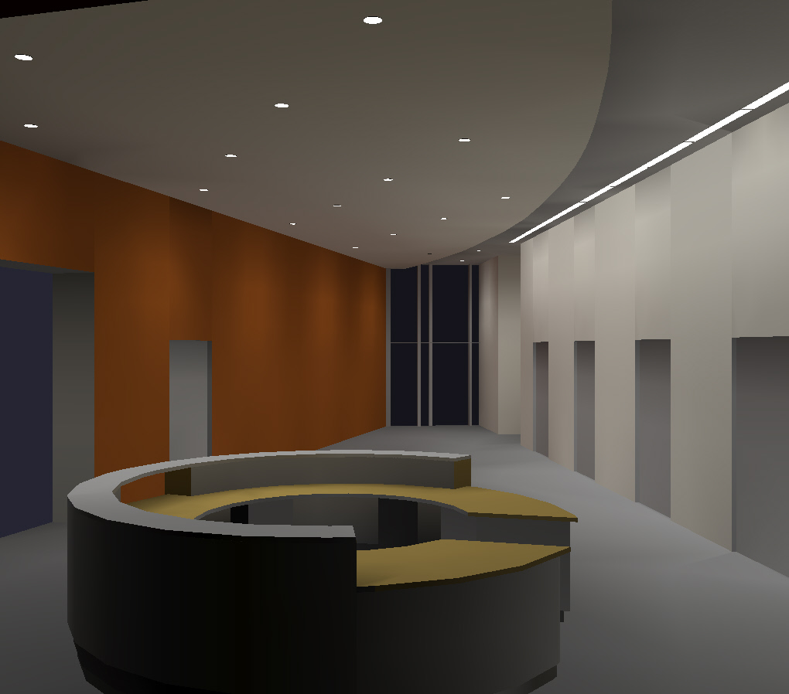
DESIGN SUMMARY
Lighting Criterion | Recommended Value | Achieved Value | Criteria Met
LPD Area Summary | < 0.9 W/ft² | 0.843 W/ft² | Yes
Average Target Illuminance | ≥ 10 fc | 22.3 fc | Yes
Desk Surface Illuminance | 15 fc | 16.8 fc | Yes
PROJECT OVERVIEW PROJECT LOCATION DESIGN CONCEPT ELEVATOR LOBBY NANOMEDICINE WORKSTATION MEETING ROOM REPORT BREADTHS ELECTRICAL DEPTH REPORT SUMMARY

Slide 26
NANOMEDICINE WORKSTATION
PROJECT OVERVIEW PROJECT LOCATION DESIGN CONCEPT ELEVATOR LOBBY NANOMEDICINE WORKSTATION MEETING ROOM REPORT BREADTHS ELECTRICAL DEPTH REPORT SUMMARY
BACKGROUND

Slide 27
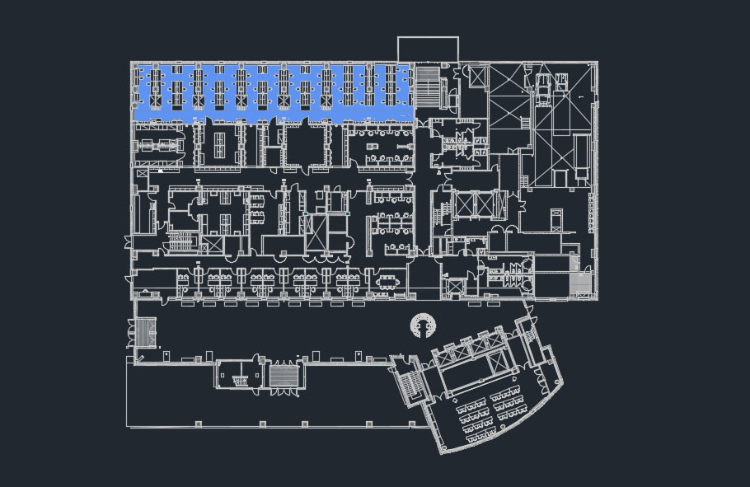
NANOMEDICINE WORKSTATION
DESIGN CRITERIA
RESEARCH AND DEVELOPMENT LAB
PRIMARILY CASEWORK, SINKS, SHELVING UNITS
MOVABLE BENCH SECTIONS WITH SHELVING
10 VENTILATION FUME HOODS
LAB SPACE
Classrooms: Science Labs | Horizontal (fc) Targets | Vertical (fc) Targets | Avg:Min
Bench | 50 | 30 | 1:5:1
H @ 3’ ; V @ 4’ 6” AFF.
Common Space Types | LPD (W/ft²)
Workshop | 1.59
PROJECT OVERVIEW PROJECT LOCATION DESIGN CONCEPT ELEVATOR LOBBY NANOMEDICINE WORKSTATION MEETING ROOM REPORT BREADTHS ELECTRICAL DEPTH REPORT SUMMARY

Slide 28
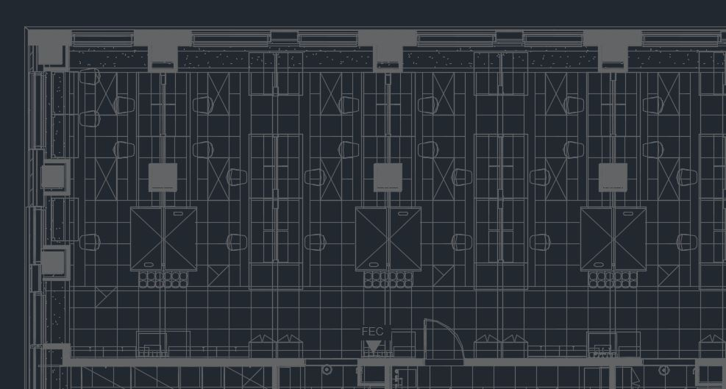
DESIGN CONSIDERATIONS
PROJECT OVERVIEW PROJECT LOCATION DESIGN CONCEPT ELEVATOR LOBBY NANOMEDICINE WORKSTATION MEETING ROOM REPORT BREADTHS ELECTRICAL DEPTH REPORT SUMMARY

Slide 29
DESIGN CONSIDERATIONS
PROVIDE TARGET ILLUMINANCE RECOMMENDED FOR SCIENCE LABS
PROJECT OVERVIEW PROJECT LOCATION DESIGN CONCEPT ELEVATOR LOBBY NANOMEDICINE WORKSTATION MEETING ROOM REPORT BREADTHS ELECTRICAL DEPTH REPORT SUMMARY

Slide 30
DESIGN CONSIDERATIONS
PROVIDE TARGET ILLUMINANCE RECOMMENDED FOR SCIENCE LABS
WORKSTATION BENCHES ARE PRIORITY
PROJECT OVERVIEW PROJECT LOCATION DESIGN CONCEPT ELEVATOR LOBBY NANOMEDICINE WORKSTATION MEETING ROOM REPORT BREADTHS ELECTRICAL DEPTH REPORT SUMMARY

Slide 31
DESIGN CONSIDERATIONS
PROVIDE TARGET ILLUMINANCE RECOMMENDED FOR SCIENCE LABS
WORKSTATION BENCHES ARE PRIORITY
AVOID SHELVING, CASEWORK, AND FUME HOODS
PROJECT OVERVIEW PROJECT LOCATION DESIGN CONCEPT ELEVATOR LOBBY NANOMEDICINE WORKSTATION MEETING ROOM REPORT BREADTHS ELECTRICAL DEPTH REPORT SUMMARY

Slide 32
LUMINAIRE SUMMARY
PROJECT OVERVIEW PROJECT LOCATION DESIGN CONCEPT ELEVATOR LOBBY NANOMEDICINE WORKSTATION MEETING ROOM REPORT BREADTHS ELECTRICAL DEPTH REPORT SUMMARY

Slide 33
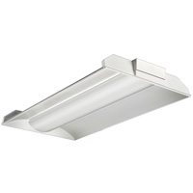
LUMINAIRE SUMMARY
RECESSED 1 x 4 LINEAR FLUORESCENT DOWNLIGHT
PROJECT OVERVIEW PROJECT LOCATION DESIGN CONCEPT ELEVATOR LOBBY NANOMEDICINE WORKSTATION MEETING ROOM REPORT BREADTHS ELECTRICAL DEPTH REPORT SUMMARY

Slide 34
LUMINAIRE SUMMARY
RECESSED 1 x 4 LINEAR FLUORESCENT DOWNLIGHT
RECESSED LED DOWNLIGHT
PROJECT OVERVIEW PROJECT LOCATION DESIGN CONCEPT ELEVATOR LOBBY NANOMEDICINE WORKSTATION MEETING ROOM REPORT BREADTHS ELECTRICAL DEPTH REPORT SUMMARY

Slide 35
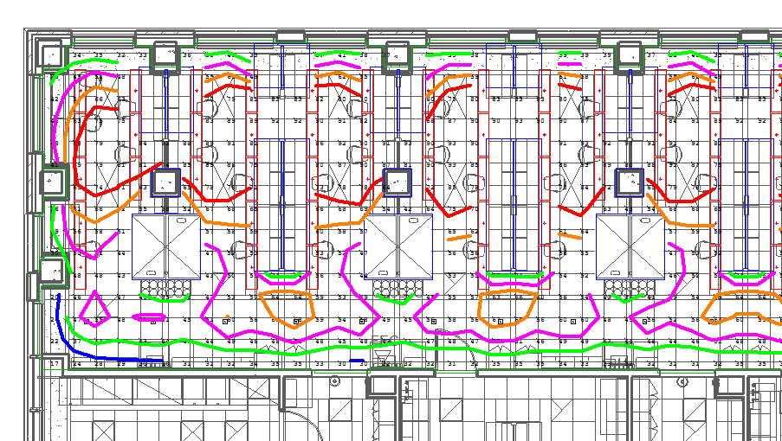
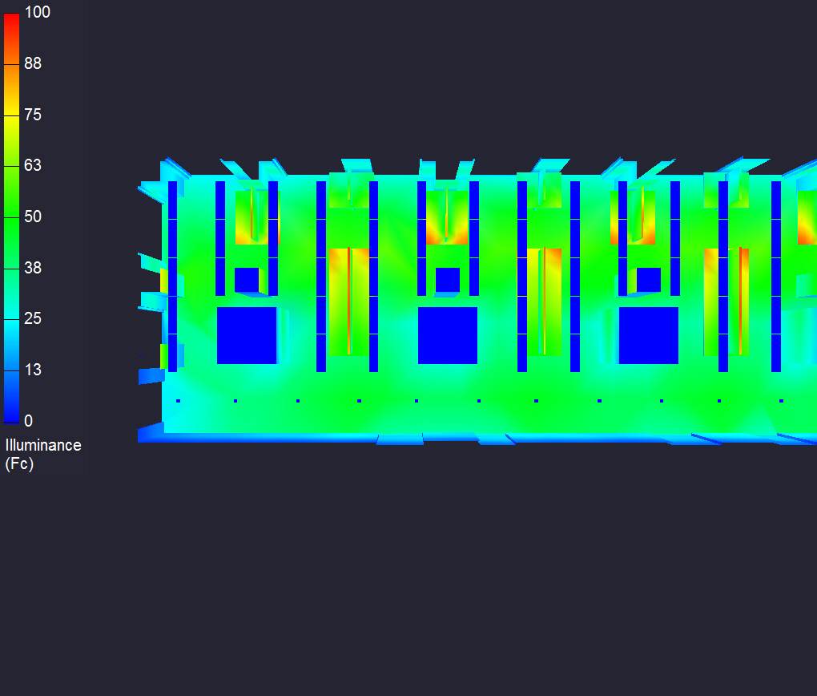
CALCULATION SUMMARY
30
40
50
60
70
PROJECT OVERVIEW PROJECT LOCATION DESIGN CONCEPT ELEVATOR LOBBY NANOMEDICINE WORKSTATION MEETING ROOM REPORT BREADTHS ELECTRICAL DEPTH REPORT SUMMARY

Slide 36
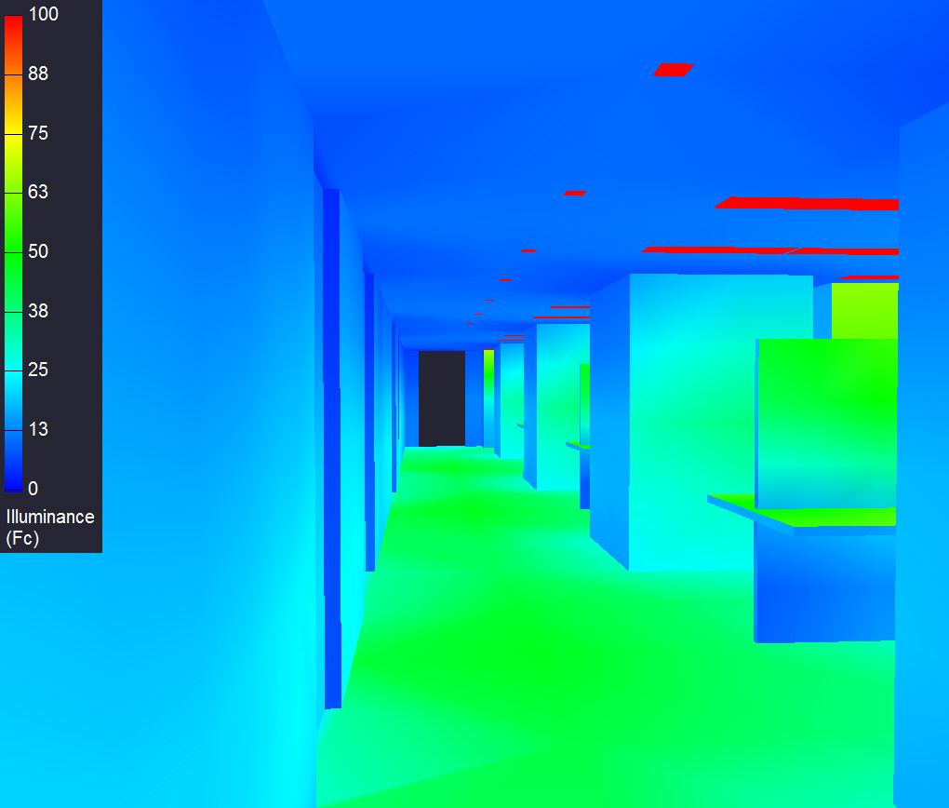
DESIGN SUMMARY
Lighting Criterion | Recommended Value | Achieved Value | Criteria Met
LPD Area Summary | < 1.59 W/ft² | 0.973 W/ft² | Yes
Average Target Illuminance | ≥ 50 fc | 62.8 fc | Yes
PROJECT OVERVIEW PROJECT LOCATION DESIGN CONCEPT ELEVATOR LOBBY NANOMEDICINE WORKSTATION MEETING ROOM REPORT BREADTHS ELECTRICAL DEPTH REPORT SUMMARY

Slide 37
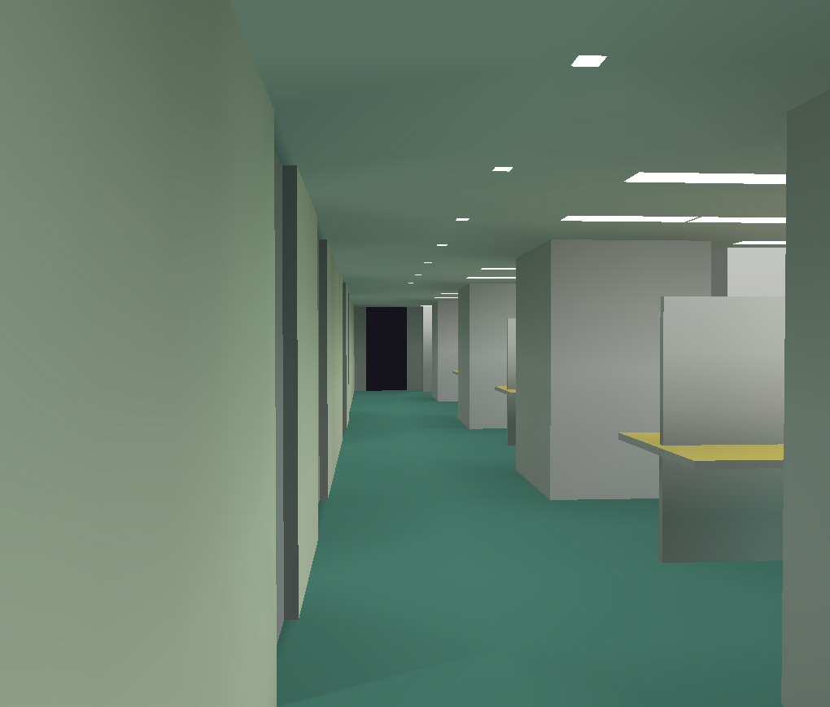
DESIGN SUMMARY
Lighting Criterion | Recommended Value | Achieved Value | Criteria Met
LPD Area Summary | < 1.59 W/ft² | 0.973 W/ft² | Yes
Average Target Illuminance | ≥ 50 fc | 62.8 fc | Yes
PROJECT OVERVIEW PROJECT LOCATION DESIGN CONCEPT ELEVATOR LOBBY NANOMEDICINE WORKSTATION MEETING ROOM REPORT BREADTHS ELECTRICAL DEPTH REPORT SUMMARY

Slide 38
MEETING ROOM
PROJECT OVERVIEW PROJECT LOCATION DESIGN CONCEPT ELEVATOR LOBBY NANOMEDICINE WORKSTATION MEETING ROOM REPORT BREADTHS ELECTRICAL DEPTH REPORT SUMMARY
BACKGROUND

Slide 39
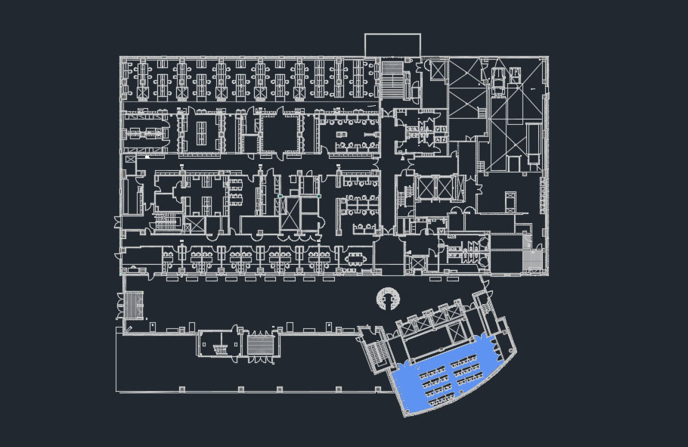
MEETING ROOM
DESIGN CRITERIA
MAIN CONFERENCE ROOM
PRESENTATION AND LECTURE SPACE
ADJUSTABLE FURNITURE TO MEET SPACE REQUIREMENTS
Conference: Meeting | Horizontal (fc) Targets | Vertical (fc) Targets | Avg:Min
Discourse | 30 | 10 | 1:5:1
H @ 2’ 6” ; V @ presentation board height.
Common Space Types | LPD (W/ft²)
Conference/Meeting | 1.23
PROJECT OVERVIEW PROJECT LOCATION DESIGN CONCEPT ELEVATOR LOBBY NANOMEDICINE WORKSTATION MEETING ROOM REPORT BREADTHS ELECTRICAL DEPTH REPORT SUMMARY

Slide 40
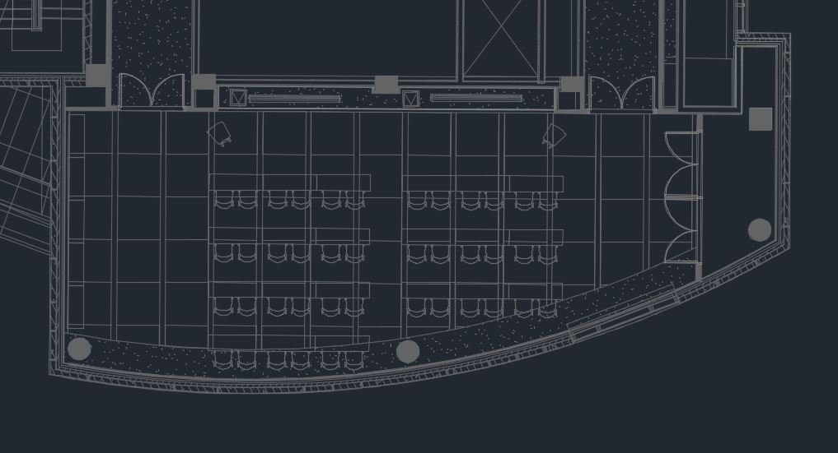
DESIGN CONSIDERATIONS
PROJECT OVERVIEW PROJECT LOCATION DESIGN CONCEPT ELEVATOR LOBBY NANOMEDICINE WORKSTATION MEETING ROOM REPORT BREADTHS ELECTRICAL DEPTH REPORT SUMMARY

Slide 41
DESIGN CONSIDERATIONS
MECHANICAL SUPPLY VENTS
PROJECT OVERVIEW PROJECT LOCATION DESIGN CONCEPT ELEVATOR LOBBY NANOMEDICINE WORKSTATION MEETING ROOM REPORT BREADTHS ELECTRICAL DEPTH REPORT SUMMARY

Slide 42
DESIGN CONSIDERATIONS
MECHANICAL SUPPLY VENTS
PROJECTOR SYSTEMS
PROJECT OVERVIEW PROJECT LOCATION DESIGN CONCEPT ELEVATOR LOBBY NANOMEDICINE WORKSTATION MEETING ROOM REPORT BREADTHS ELECTRICAL DEPTH REPORT SUMMARY

Slide 43
LUMINAIRE SUMMARY
PROJECT OVERVIEW PROJECT LOCATION DESIGN CONCEPT ELEVATOR LOBBY NANOMEDICINE WORKSTATION MEETING ROOM REPORT BREADTHS ELECTRICAL DEPTH REPORT SUMMARY

Slide 44
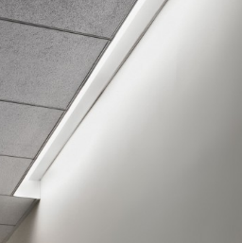
LUMINAIRE SUMMARY
RECESSED LED SLOT LUMINAIRE
PROJECT OVERVIEW PROJECT LOCATION DESIGN CONCEPT ELEVATOR LOBBY NANOMEDICINE WORKSTATION MEETING ROOM REPORT BREADTHS ELECTRICAL DEPTH REPORT SUMMARY

Slide 45

LUMINAIRE SUMMARY
RECESSED LED SLOT LUMINAIRE
RECESSED LED LINEAR DOWNLIGHT
PROJECT OVERVIEW PROJECT LOCATION DESIGN CONCEPT ELEVATOR LOBBY NANOMEDICINE WORKSTATION MEETING ROOM REPORT BREADTHS ELECTRICAL DEPTH REPORT SUMMARY

Slide 46
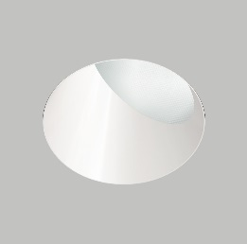
LUMINAIRE SUMMARY
RECESSED LED SLOT LUMINAIRE
RECESSED LED LINEAR DOWNLIGHT
RECESSED LED WALL WASHERS
PROJECT OVERVIEW PROJECT LOCATION DESIGN CONCEPT ELEVATOR LOBBY NANOMEDICINE WORKSTATION MEETING ROOM REPORT BREADTHS ELECTRICAL DEPTH REPORT SUMMARY

Slide 47
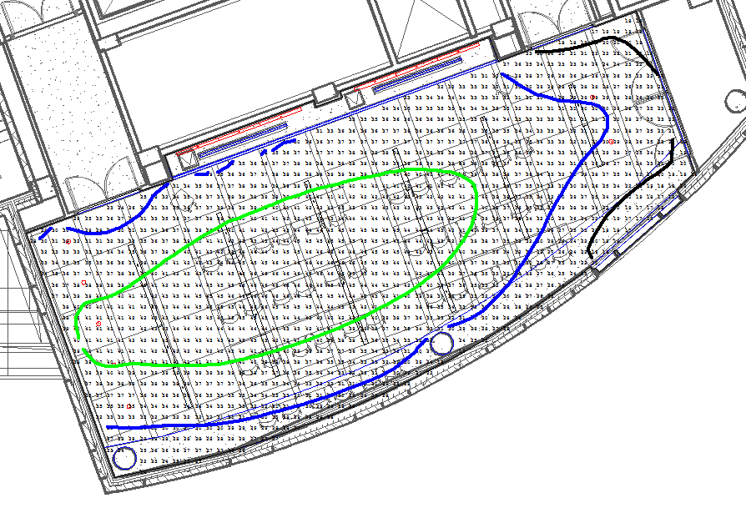
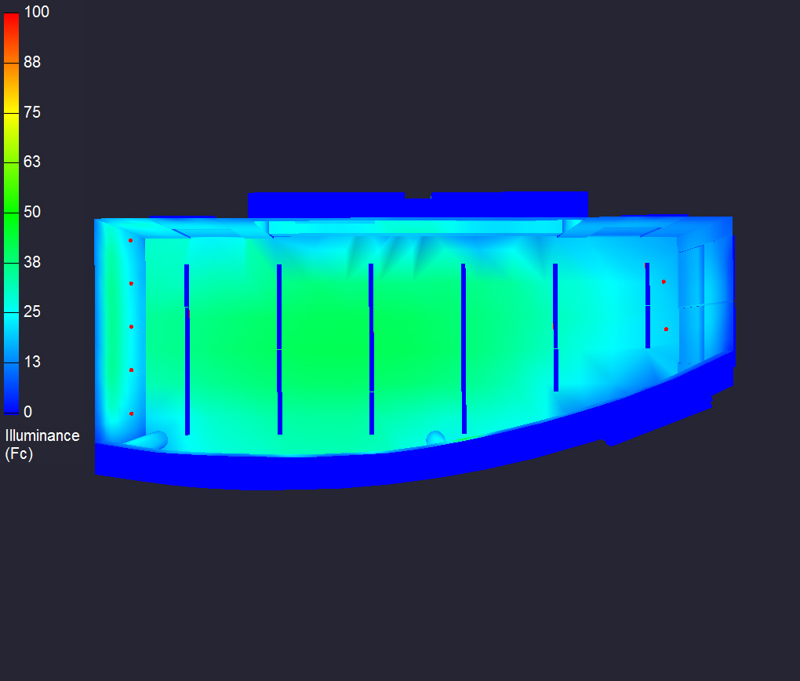
CALCULATION SUMMARY
20
30
40
PROJECT OVERVIEW PROJECT LOCATION DESIGN CONCEPT ELEVATOR LOBBY NANOMEDICINE WORKSTATION MEETING ROOM REPORT BREADTHS ELECTRICAL DEPTH REPORT SUMMARY

Slide 48
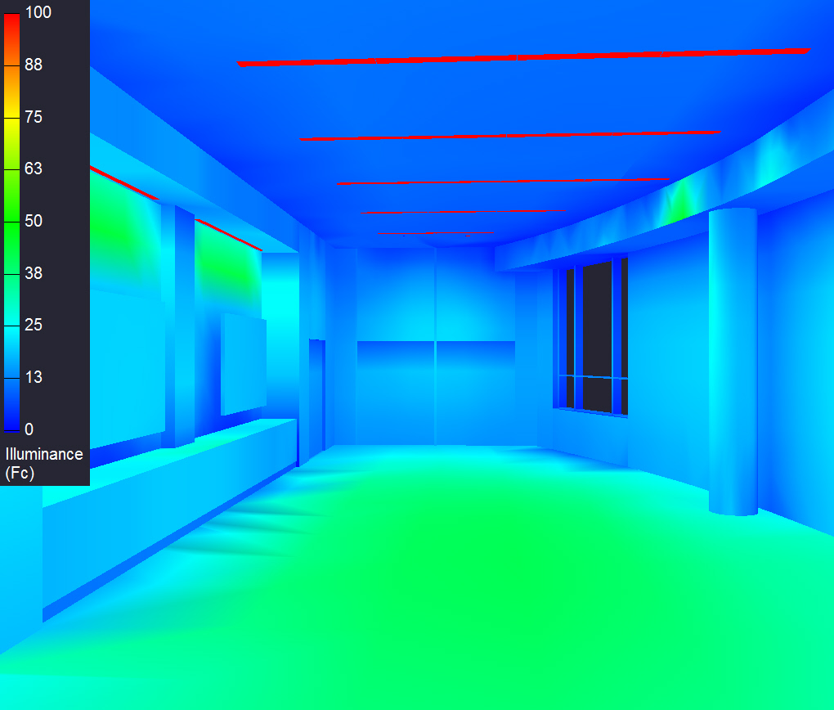
DESIGN SUMMARY
Lighting Criterion | Recommended Value | Achieved Value | Criteria Met
LPD Area Summary | < 1.23 W/ft² | 0.685 W/ft² | Yes
Average Target Illuminance | ≥ 30 fc | 34.9 fc | Yes
PROJECT OVERVIEW PROJECT LOCATION DESIGN CONCEPT ELEVATOR LOBBY NANOMEDICINE WORKSTATION MEETING ROOM REPORT BREADTHS ELECTRICAL DEPTH REPORT SUMMARY

Slide 49
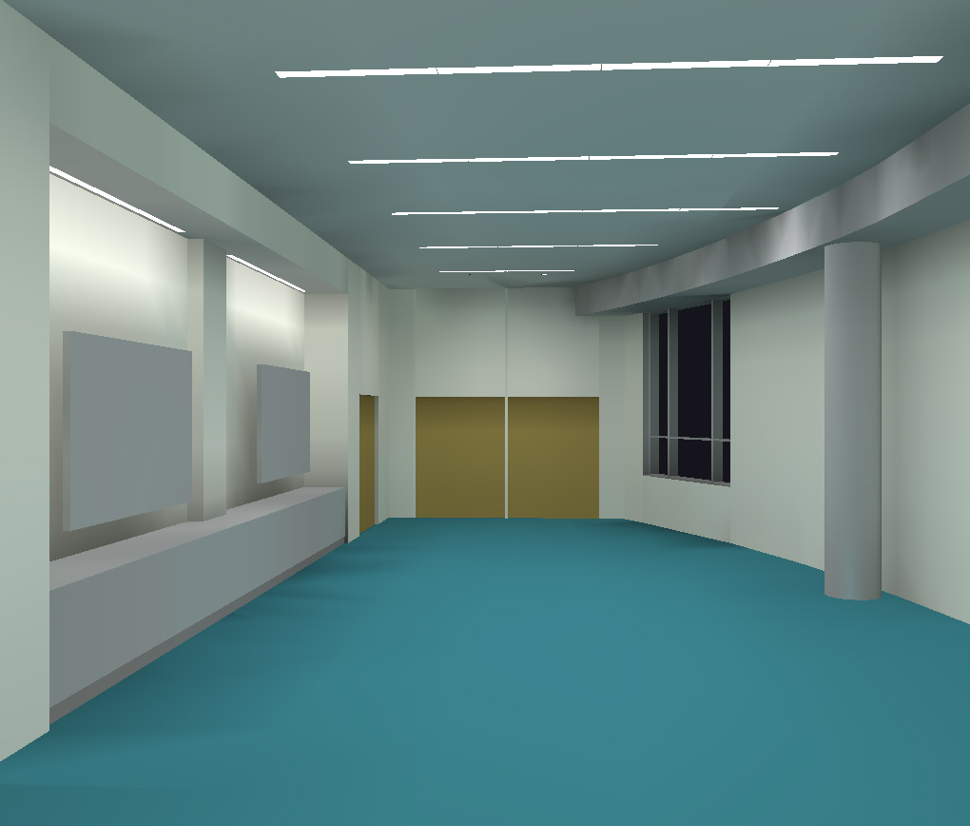
DESIGN SUMMARY
Lighting Criterion | Recommended Value | Achieved Value | Criteria Met
LPD Area Summary | < 1.23 W/ft² | 0.685 W/ft² | Yes
Average Target Illuminance | ≥ 30 fc | 34.9 fc | Yes
PROJECT OVERVIEW PROJECT LOCATION DESIGN CONCEPT ELEVATOR LOBBY NANOMEDICINE WORKSTATION MEETING ROOM REPORT BREADTHS ELECTRICAL DEPTH REPORT SUMMARY

Slide 50
REPORT BREADTHS
PROJECT OVERVIEW PROJECT LOCATION DESIGN CONCEPT ELEVATOR LOBBY NANOMEDICINE WORKSTATION MEETING ROOM REPORT BREADTHS ELECTRICAL DEPTH REPORT SUMMARY
BACKGROUND

Slide 51
FAÇADE BREADTH STUDY
RAIN SCREEN ADDED TO EXTERIOR
STRUCTURAL BREADTH STUDY
RAIN SCREEN LOAD SUMMARY
PROJECT OVERVIEW PROJECT LOCATION DESIGN CONCEPT ELEVATOR LOBBY NANOMEDICINE WORKSTATION MEETING ROOM REPORT BREADTHS ELECTRICAL DEPTH REPORT SUMMARY
BACKGROUND

Slide 52
ELECTRICAL DEPTH
PROJECT OVERVIEW PROJECT LOCATION DESIGN CONCEPT ELEVATOR LOBBY NANOMEDICINE WORKSTATION MEETING ROOM REPORT BREADTHS ELECTRICAL DEPTH REPORT SUMMARY
BACKGROUND

Slide 53
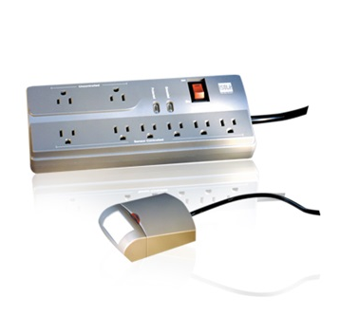
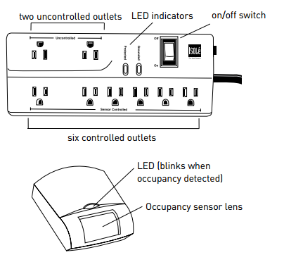
ENERGY SAVINGS
WATTSTOPPER Isolé IDP-3050 Power Strip with Personal Sensor IDP-3050-A, DI-110
CONTROLS DESKTOP EQUIPMENT
SAVES ENERGY WITH PERSONAL OCCUPANCY SENSOR
CONSISTS OF 8 OUTLET STRIP (6 CONTROLLED BY OCUPANCY)
EQUIPPED WITH SURGE PROTECTION
PROJECT OVERVIEW PROJECT LOCATION DESIGN CONCEPT ELEVATOR LOBBY NANOMEDICINE WORKSTATION MEETING ROOM REPORT BREADTHS ELECTRICAL DEPTH REPORT SUMMARY
BACKGROUND

Slide 54
ENERGY SAVINGS
USED PRIMARILY IN OFFICE SPACE
8 FLOORS OFFICE SPACE
TOTAL SUPPLY RATE OF THE BUILDING = 15.458 C/KWH
INITIAL STUDY SHOWS NEW SUPPLY RATE = 13.912 C/KWH
SAVING ROUGHLY 10%
PROJECT OVERVIEW PROJECT LOCATION DESIGN CONCEPT ELEVATOR LOBBY NANOMEDICINE WORKSTATION MEETING ROOM REPORT BREADTHS ELECTRICAL DEPTH REPORT SUMMARY
BACKGROUND

Slide 55
REPORT SUMMARY
PROJECT OVERVIEW PROJECT LOCATION DESIGN CONCEPT ELEVATOR LOBBY NANOMEDICINE WORKSTATION MEETING ROOM REPORT BREADTHS ELECTRICAL DEPTH REPORT SUMMARY
BACKGROUND

Slide 56
HIGHLY ADVANCED RESEARCH FACILITY
HOUSES RESEARCH GROUPS FOR SCHOOLS OF MEDICINE, PHARMACY, AND DENTISTRY
SHARE NANOMEDICINE CENTER
CENTRAL CAMPUS LOCATION
HEART OF BALTIMORE
EXPECTED COMPLETION DATE – SEPTEMBER 2017
PROJECT OVERVIEW PROJECT LOCATION DESIGN CONCEPT ELEVATOR LOBBY NANOMEDICINE WORKSTATION MEETING ROOM REPORT BREADTHS ELECTRICAL DEPTH REPORT SUMMARY
BACKGROUND

Slide 57
ELEVATOR LOBBY
WORKSTATION
MEETING ROOM
Lighting Criterion | Recommended Value | Achieved Value | Criteria Met
LPD Area Summary | < 0.9 W/ft² | 0.843 W/ft² | Yes
Average Target Illuminance | ≥ 10 fc | 22.3 fc | Yes
Desk Surface Illuminance | 15 fc | 16.8 fc | Yes
Lighting Criterion | Recommended Value | Achieved Value | Criteria Met
LPD Area Summary | < 1.59 W/ft² | 0.973 W/ft² | Yes
Average Target Illuminance | ≥ 50 fc | 62.8 fc | Yes
Lighting Criterion | Recommended Value | Achieved Value | Criteria Met
LPD Area Summary | < 1.23 W/ft² | 0.685 W/ft² | Yes
Average Target Illuminance | ≥ 30 fc | 34.9 fc | Yes
PROJECT OVERVIEW PROJECT LOCATION DESIGN CONCEPT ELEVATOR LOBBY NANOMEDICINE WORKSTATION MEETING ROOM REPORT BREADTHS ELECTRICAL DEPTH REPORT SUMMARY
BACKGROUND

Slide 58
Dilaura, D. L., Houser, K. W., Mistrick R. G., Steffy G. R. (2011). The Lighting Handbook (10th ed.). New York, NY: Illuminating Engineering Society.
ASHRAE Standard 90.1 – Energy Standard for Buildings Except Low-Rise Residential Buildings. 2010th ed. ASHRAE. Print.
http://www.hok.com/design/type/science-technology/university-of-maryland-baltimore-health-sciences-facility-iii/
http://www.wattstopper.com/products/sensors/plug-load-controls/idp-3050.aspx#.VS4_EU3wvGh
THANK YOU
PROJECT OVERVIEW PROJECT LOCATION DESIGN CONCEPT ELEVATOR LOBBY NANOMEDICINE WORKSTATION MEETING ROOM REPORT BREADTHS ELECTRICAL DEPTH REPORT SUMMARY
BACKGROUND

